Slide 1
Lecture 3
Prokaryotic Cell Structure and Function
Talaro’s Foundations in Microbiology
12th Edition
Barry Chess

Slide 2
We will discuss about:
Prokaryotic Cell Structure and Function
Appendages
Differences in the composition of Gram positive and Gram negative cell walls
Non-atypical cell walls
Bacterial endospores and their medical significance.

Slide 3
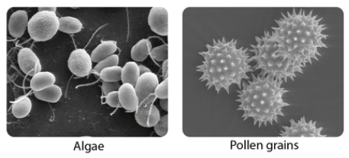
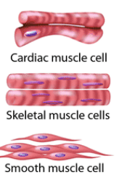
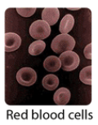
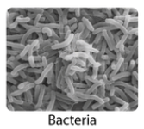
Characteristics of Cells and Life
All living things (single and multicellular) are made of cells that share some common characteristics:
  Basic shape – spherical, cubical, cylindrical
  Internal content – cytoplasm, surrounded by a membrane
  DNA chromosome(s), ribosomes, metabolic capabilities
Two basic cell types: eukaryotic and prokaryotic
Figure: Basic shapes of cells

Slide 4
Characteristics of Cells 1
Eukaryotic cells: animals, plants, fungi, and protists
  Contain membrane-bound organelles that compartmentalize the cytoplasm and perform specific functions
  Contain double-membrane bound nucleus with DNA chromosomes
Prokaryotic cells: bacteria and archaea
  No nucleus or other membrane-bound organelles

Slide 5
Characteristics of Cells
Heredity is the transmission of an organism's genome to the next generation by chromosomes, which carry DNA, the molecular blueprint of life.
Growth has two general meanings in microbiology. In the usual sense, it means an increase in size of population through reproduction. In another case, it refers to the enlargement of a single organism during maturation.
Responsiveness is the capacity of cells to interact with external factors. Cells react to stimuli from their environment, like light, chemicals, or other cells.
Metabolism encompasses the thousands of chemical reactions that all cells need to function. Generally, these reactions either synthesize new cell components or release energy that drives cellular activities.
Transport is a system for controlling the flow of materials. This includes carrying nutrients and water from the external environment into the cell’s interior. Without these raw materials, metabolism would cease.
Reproduction involves the generation of offspring necessary to continue a species line of evolution. All organisms display asexual reproduction, with one cell simply dividing into two new cells by fission or mitosis. Many organisms also display sexual reproduction, involving the union of sex cells from two parents.

Slide 6
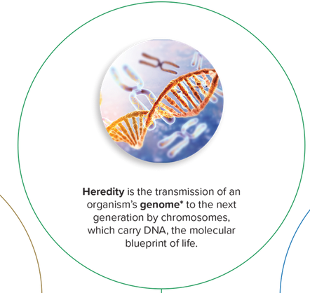
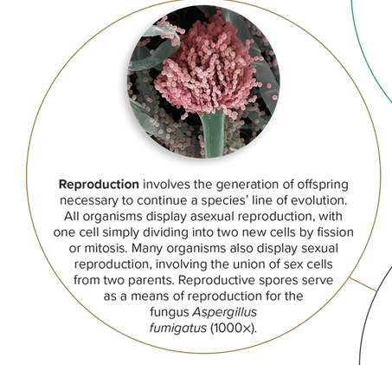
Characteristics of Cells

Slide 7
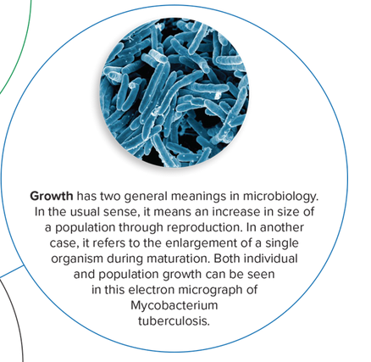
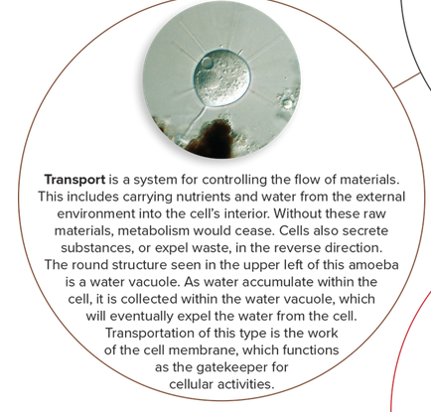
Characteristics of Cells

Slide 8
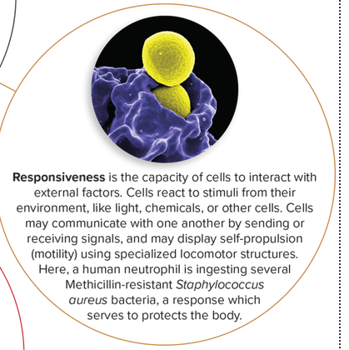
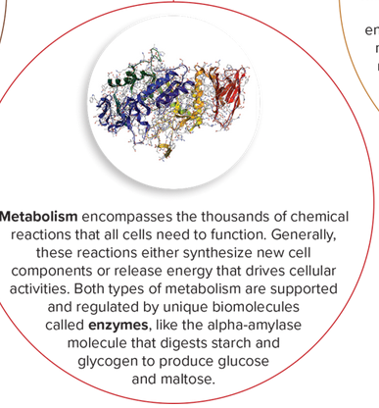
Characteristics of Cells

Slide 9
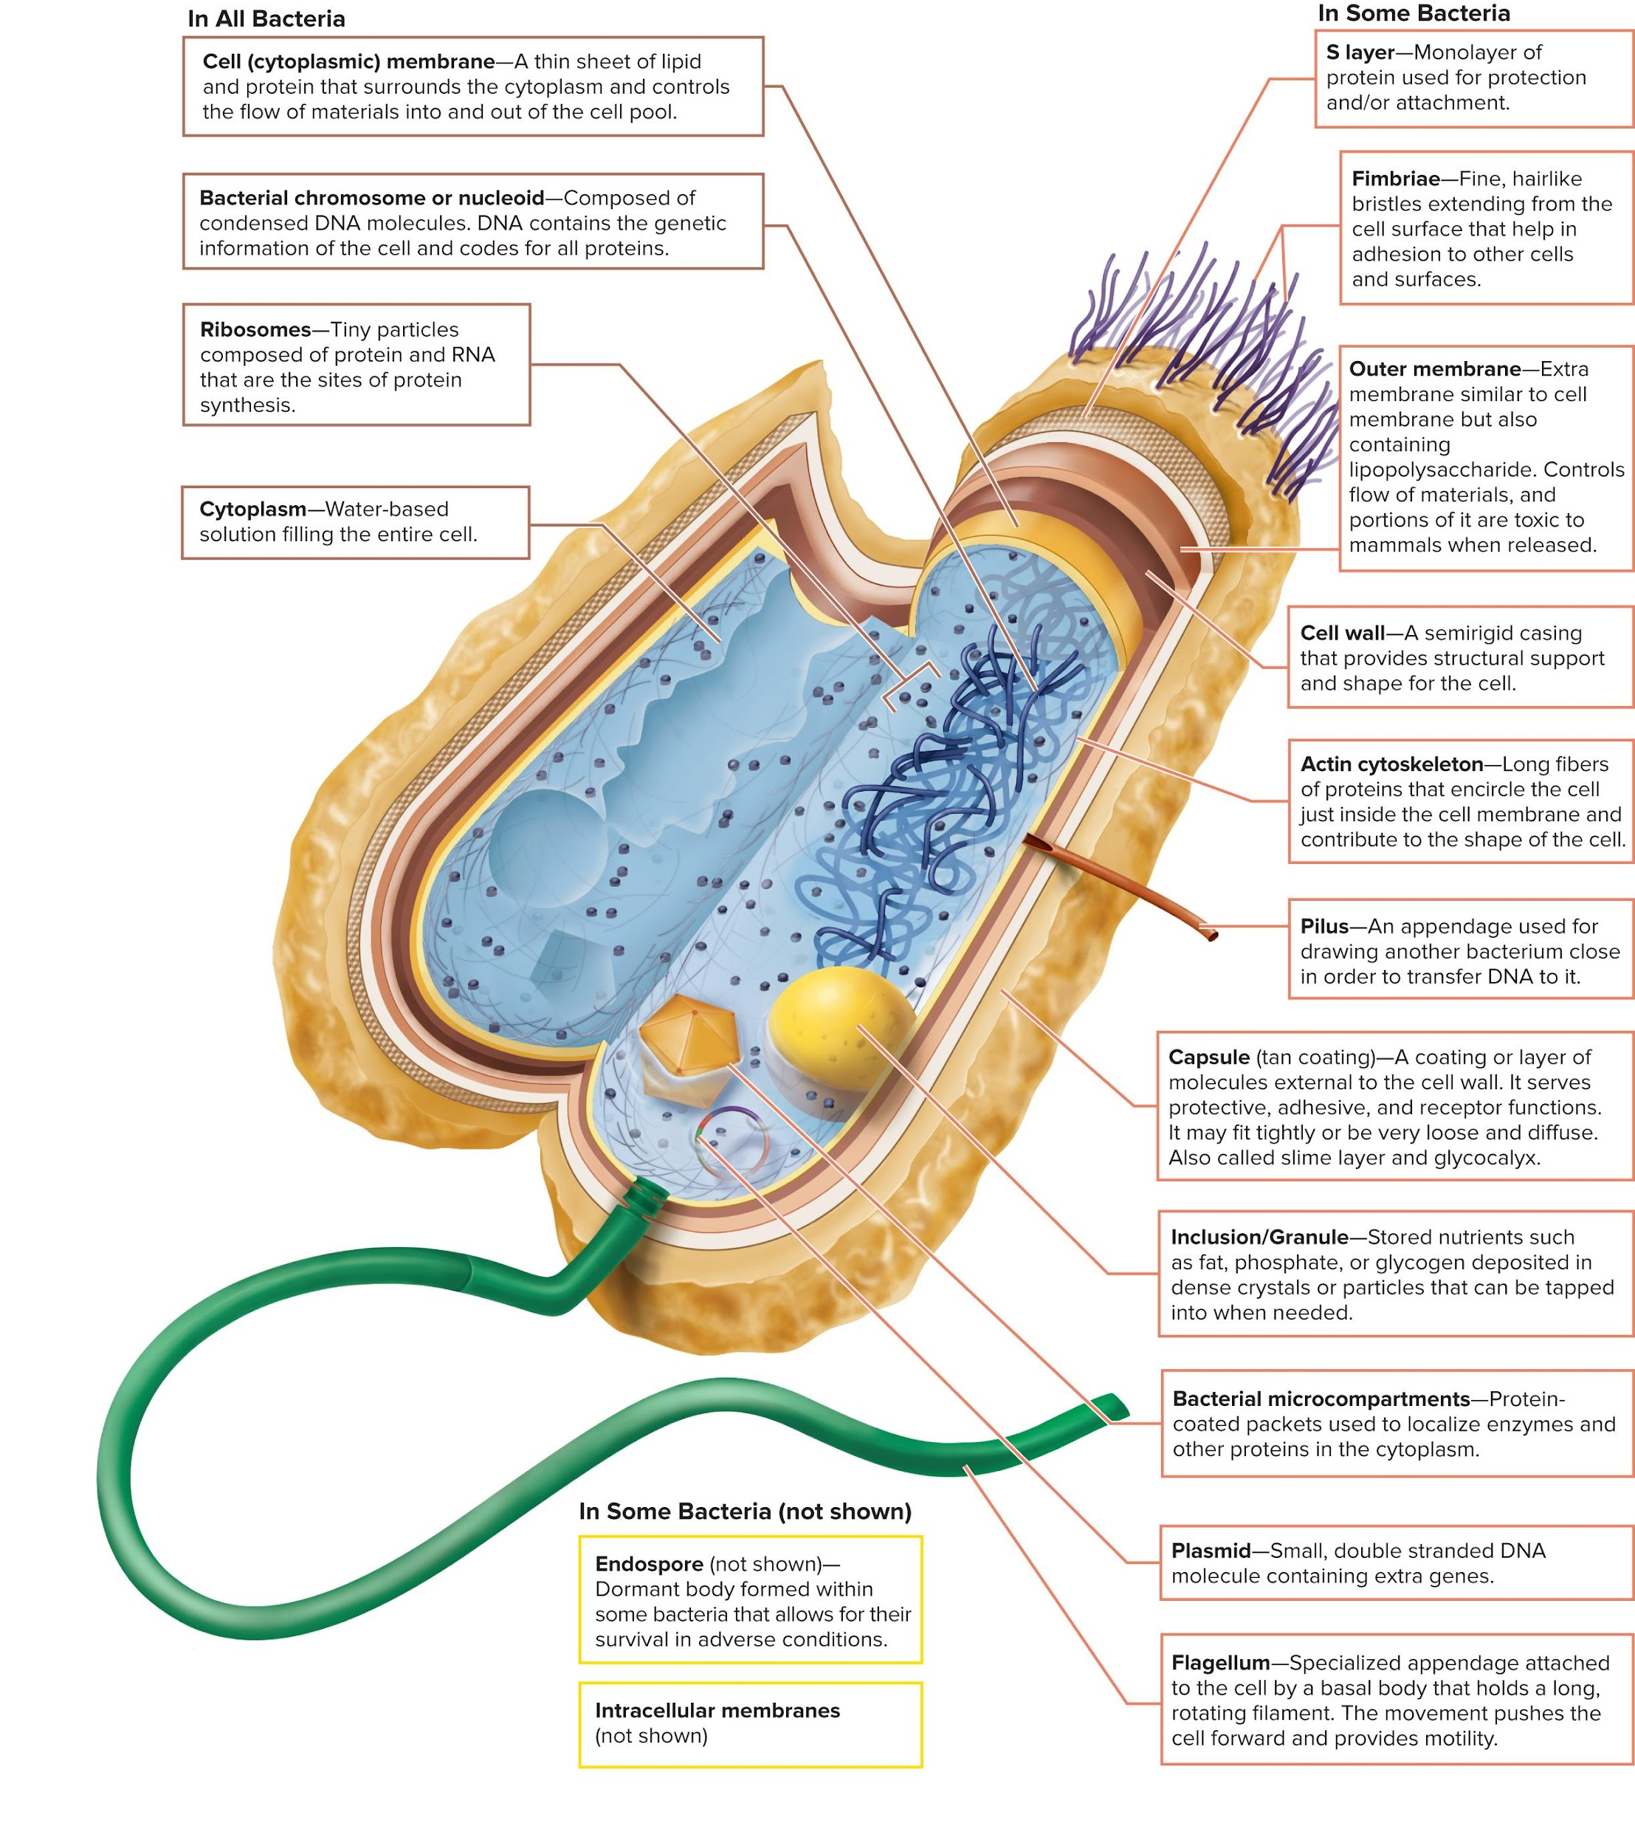
Structure of a Bacterial Cell

Slide 10
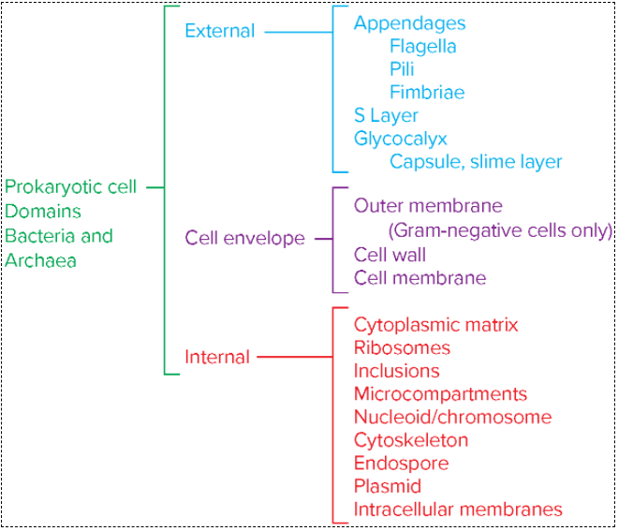
General Structural Plan of a Prokaryotic Cell

Slide 11
External Structures
1. Appendages - Accessory structure that sprouts from the surface of bacteria.
They can be divided into two major groups: those that provide motility and those that enable adhesion.
  Two major groups of appendages:
    Flagella - responsible for bacterial mobility or self-propulsion. Allows a cell to swim freely through an aqueous habitat.
    Attachment or channels – fimbriae and pili
2. Glycocalyx – surface coating

Slide 12
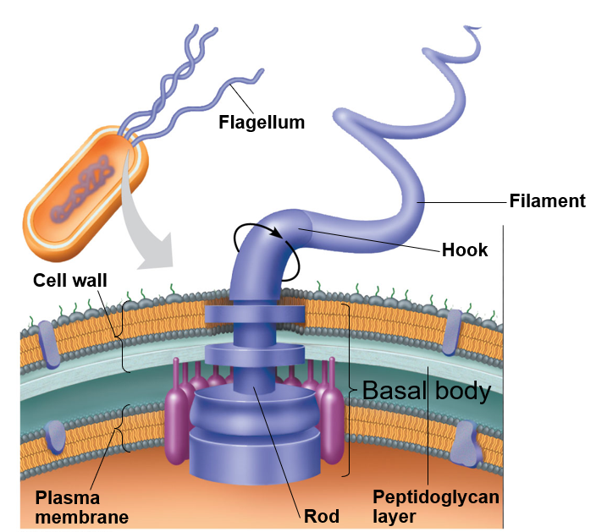
Flagella
3 parts:
  Filament – long, thin, helical structure composed of protein flagellin
  Hook – curved sheath
  Basal body – stack of rings firmly anchored in cell wall

Slide 13
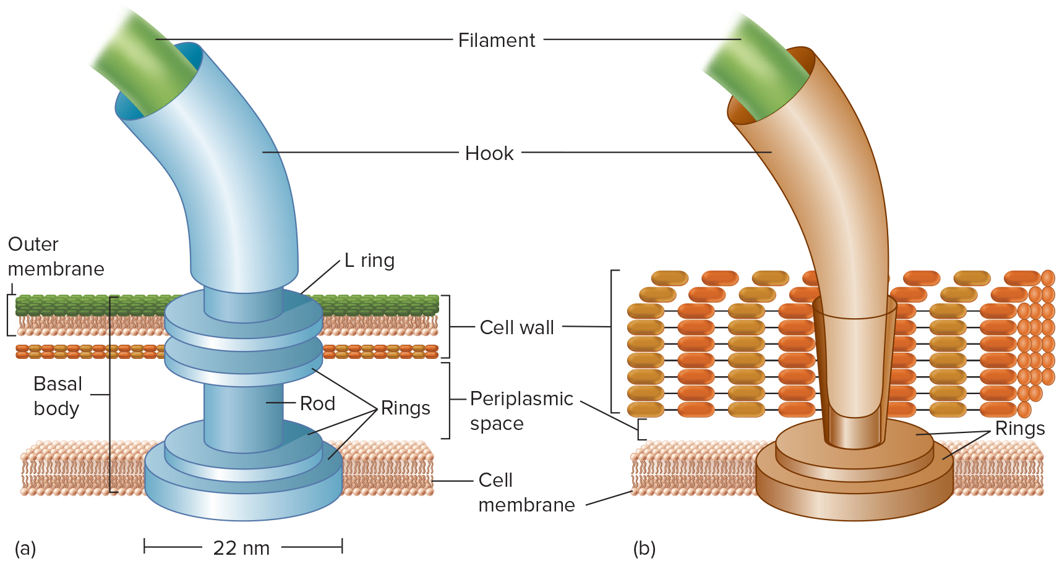
Flagella
(A) the structure of gram-negative cells, where the filament is within the hook resting on the basal body formed by an L ring, rod, and rings on top and bottom of the rod. The rings at the bottom rest on the cell membrane. The periplasmic space and cell wall are labeled above the cell membrane.
(B) the structure in gram-positive cells, where the filament is wrapped within the hook resting on the rings at the bottom of the cell membrane. The cell wall covers the predominant portion.

Slide 14
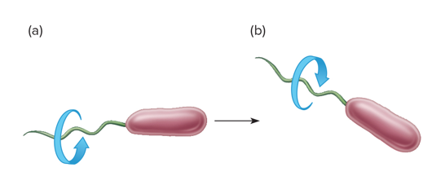
Flagella
Rotates 360°
Functions in motility of cell through environment
(a) When a polar flagellum rotates in a counterclockwise direction, the cell swims forward in runs.
(b) When the flagellum reverses direction and rotates clockwise, the cell stops and tumbles.

Slide 15
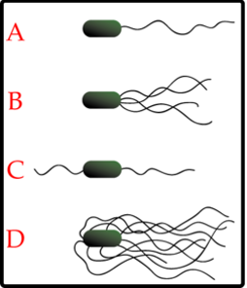
Flagellar Arrangements 1
The flagella are attached at one or both ends of the cell or are dispersed over the surface of the cell.
Monotrichous – single flagellum at one end
Lophotrichous – small bunches emerging from the same site
Amphitrichous – flagella at both ends of cell
Peritrichous – flagella dispersed over surface of cell
A = monotrichous
B = amphitrichous
C = lophotrichous
D = peritrichous

Slide 16
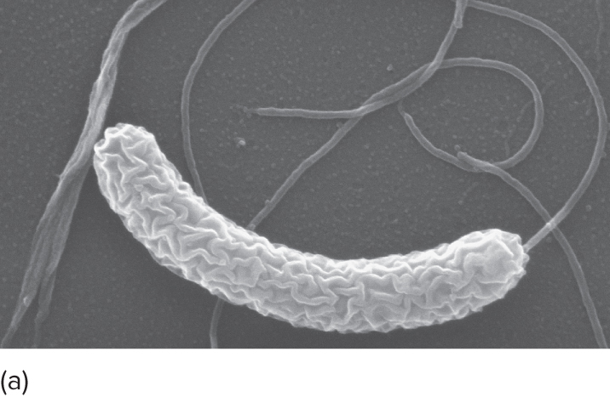
Flagellar Arrangements 2
Flagellum
Monotrichous – single flagellum at one end
Monotrichous flagellum on the pathogen Vibrio cholerae (10,000 x).
(a): Source: Louisa Howard/Dartmouth Electron Microscope Facility;

Slide 17
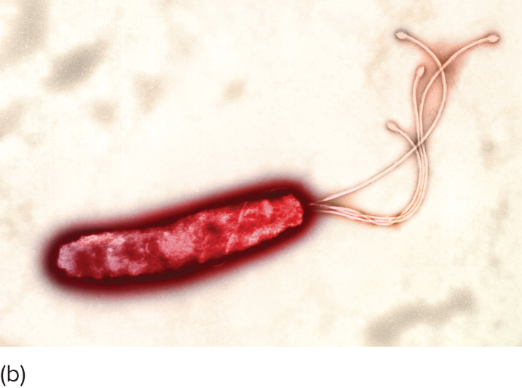
Flagellar Arrangements 3
Flagellum
Lophotrichous – small bunches emerging from the same site
Lophotrichous flagella on Helicobacter pylori, a cause of stomach ulcers (14,000x).
(b): Heather Davies/Science Source

Slide 18
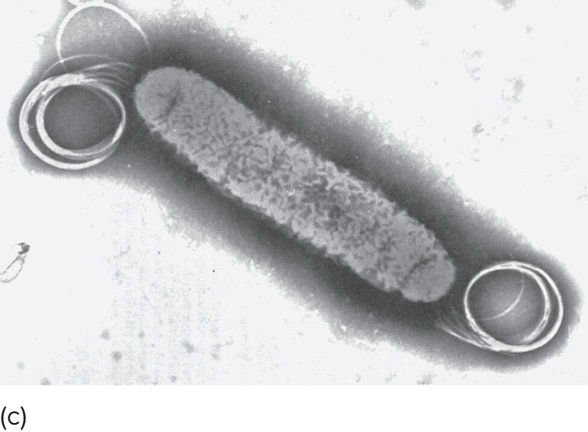
Flagellar Arrangements 4
Flagellum
Amphitrichous – flagella at both ends of cell
Amphitrichous flagella of Aquasprillum (75,000x).

Slide 19
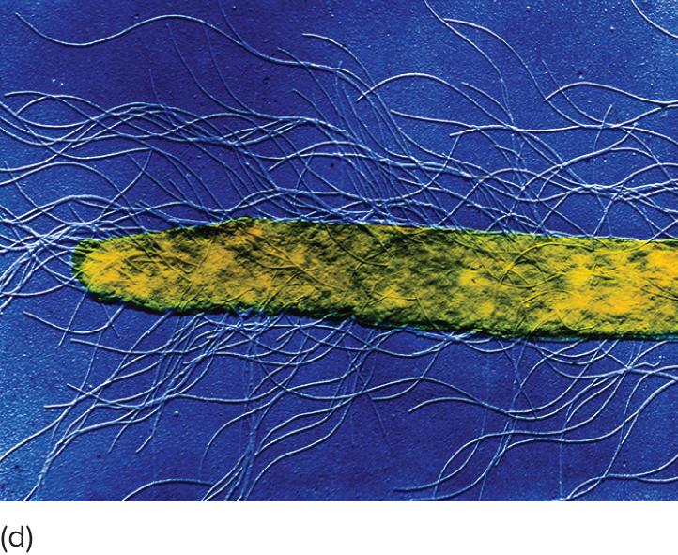
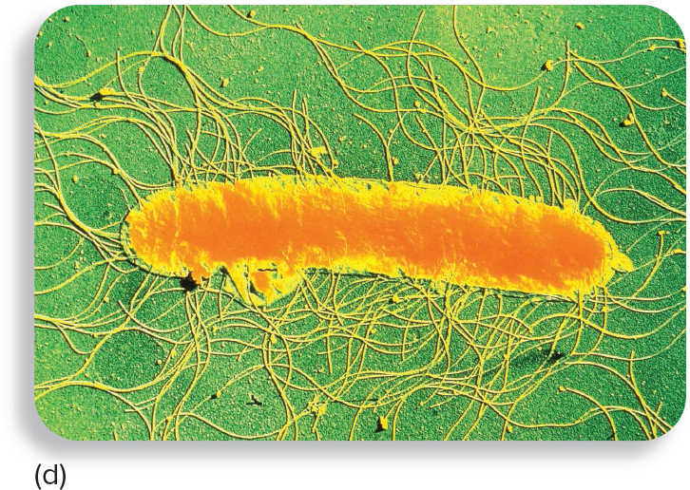
Flagellar Arrangements 5
Flagellum
Peritrichous – flagella dispersed over surface of cell
Peritrichous flagella of Proteus mirabilis (10,000x).

Slide 20
Flagellar Responses 1
Functions as more than just a locomotor device.
They are sensory appendages that can detect and respond to environmental signals.
Guide bacteria in a direction in response to external stimulus:
  Chemical stimuli – chemotaxis; positive and negative
  Light stimuli – phototaxis

Slide 21
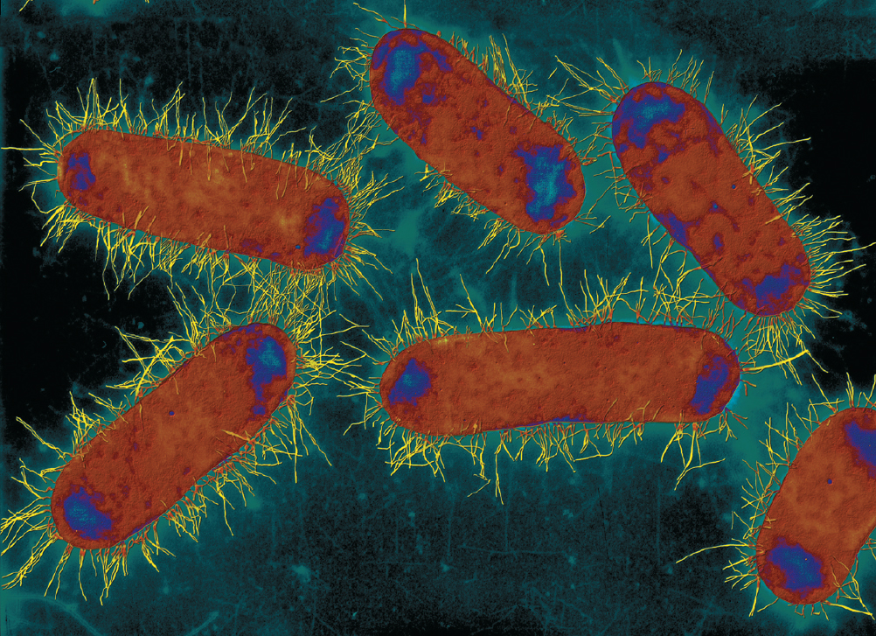
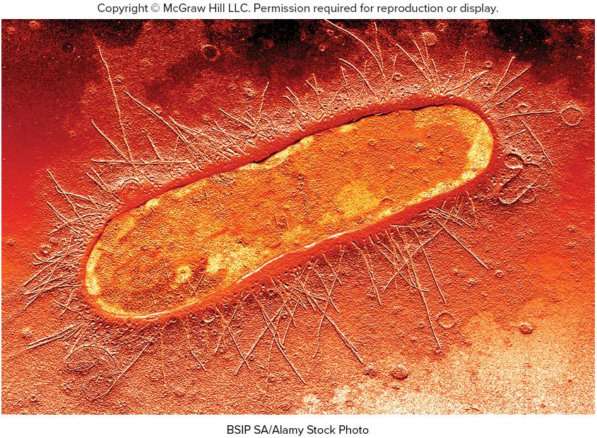
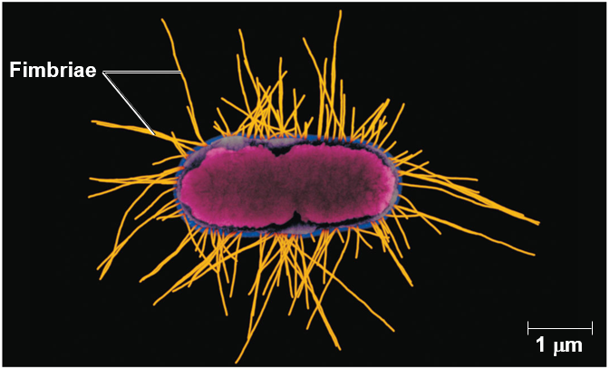
Fimbriae 1
Fine, proteinaceous, hair like bristles emerging from the cell surface.
Function in adhesion to other cells and surfaces

Slide 22
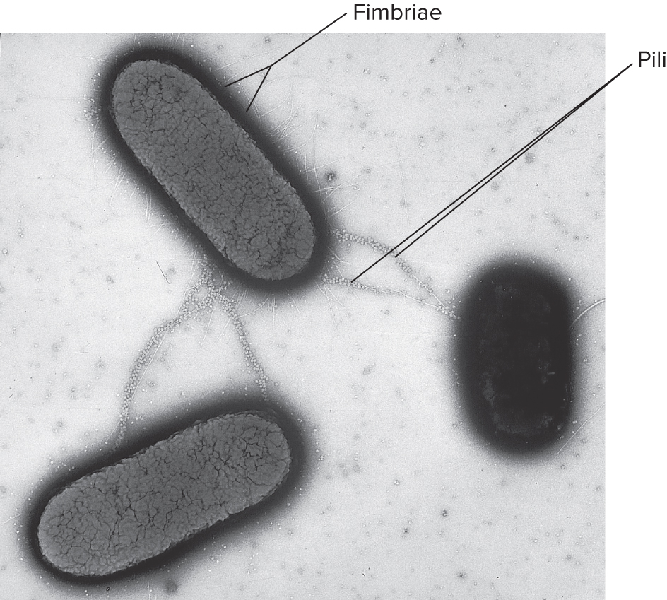
Pili 1
Rigid tubular structure made of pilin protein
Found only in gram-negative cells
Function to join bacterial cells for partial DNA transfer called conjugation

Slide 23
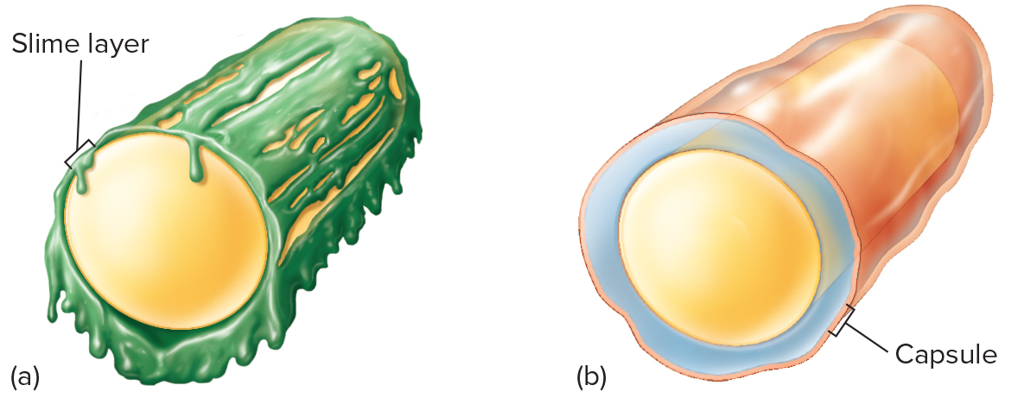
Bacterial surface coatings
Glycocalyx 1
Coating of molecules external to the cell wall, made of sugars and/or proteins
Two types:
  (a) Slime layer - loosely organized and attached on the outer surface of the cylindrical cell
  (b) Capsule - highly organized, tightly attached on the outer surface of the cylindrical cell.

Slide 24
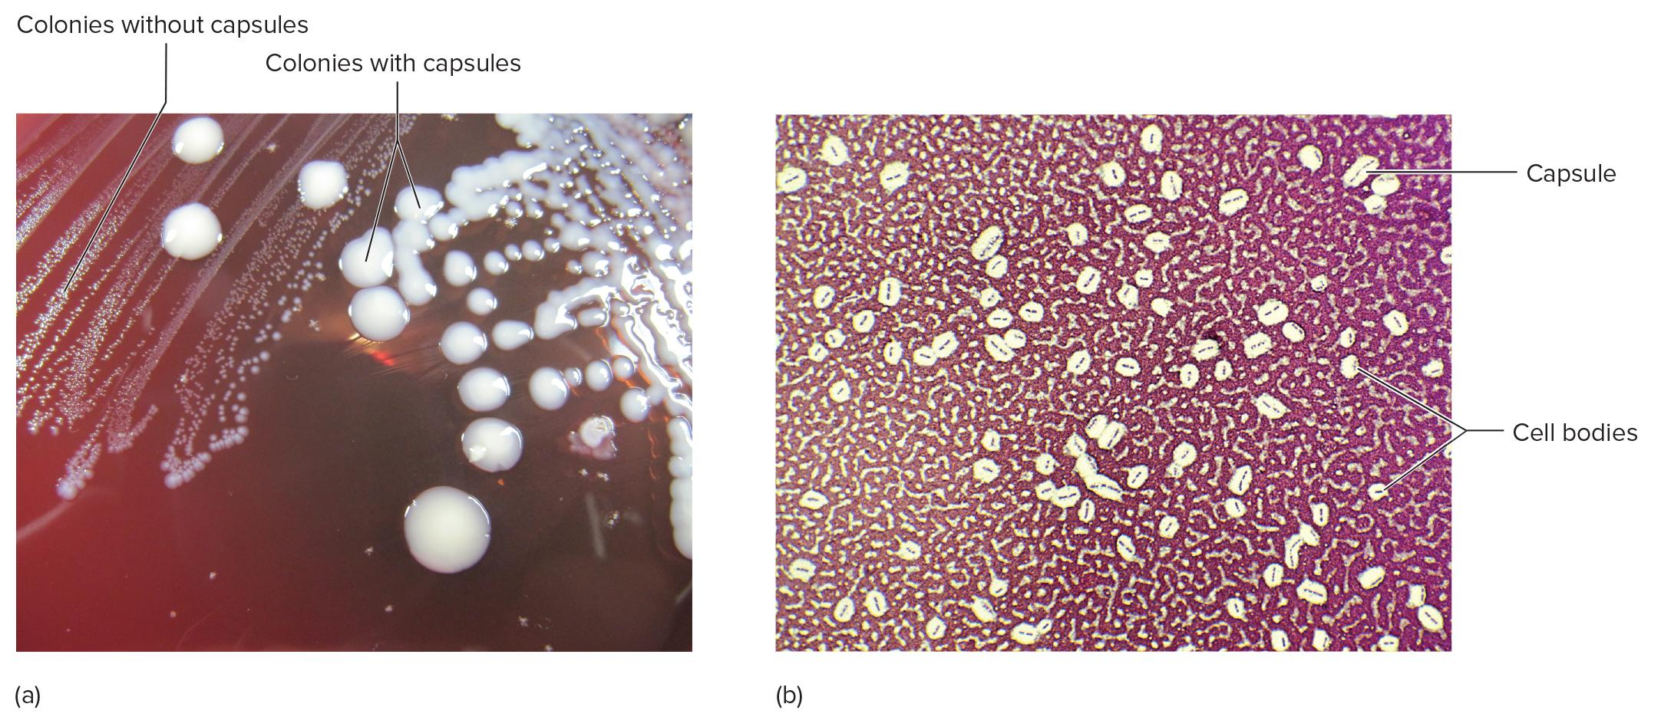
Functions of the Glycocalyx 2
Part A depicts the Streptococcus mutans, wherein the colonies without capsules are noted to be having striped patterns on one side, and on the other side, the round-shaped pearl-like capsules in the colonies are noted.

Slide 25
Functions of the Glycocalyx 3
Part B depicts the micrograph with circular-shaped cell bodies and the elongated capsules labeled at 1,000X magnification.

Slide 26
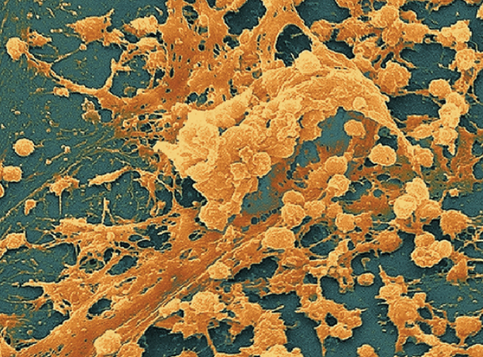
Functions of the Glycocalyx 1
Protect cells from dehydration and nutrient loss
Inhibit killing by white blood cells by phagocytosis, contributing to pathogenicity
Attachment - formation of biofilms
Biofilms - A complex aggregate of interacting microbial cells that adhere to each other and to surfaces by means of a polysaccharide matrix.

Slide 27
The Cell Envelope
External covering outside the cytoplasm
Composed of two basic layers:
  Cell wall and cell membrane
Maintains cell integrity
Two different groups of bacteria demonstrated by Gram stain:
  Gram-positive bacteria: thick cell wall composed primarily of peptidoglycan and cell membrane
  Gram-negative bacteria: outer cell membrane, thin peptidoglycan layer, and cell membrane

Slide 28
Structure of Cell Walls 1
Determines cell shape, prevents lysis due to changing osmotic pressures
Peptidoglycan is the primary component:
  Unique macromolecule composed of a repeating framework of long glycan (a polysaccharide) chains cross-linked by short peptide fragments

Slide 29
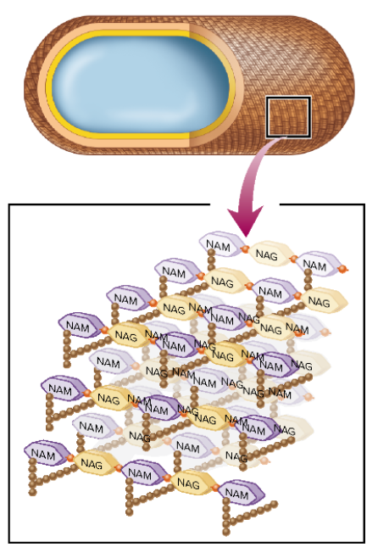
Structure of Cell Walls 2
The figure of the “Structure of Cell Walls.”
The peptidoglycan of a cell wall is a huge, three-dimensional latticework that is actually one giant molecule to surround and support the cell.
This shows the molecular pattern of peptidoglycan. It has alternating glycans (NAG and NAM) bound together in long strands. The NAG stands for N-acetyl glucosamine, and the NAM stands for N-acetyl muramic acid.
Adjacent muramic acid molecules on parallel chains are bound by a cross-linkage of peptides (brown spheres).

Slide 30
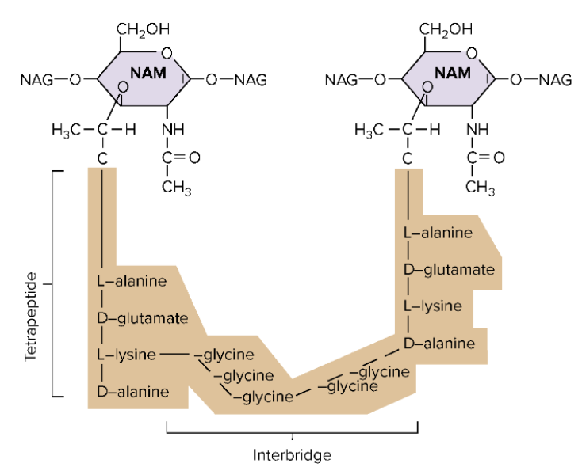
Structure of Cell Walls 3
The figure of the “Structure of Cell Walls” continues on this slide.
An enlarged view of the links between the NAM molecules. Tetrapeptide chains branching off the muramic acids connect by amino acid interbridges.
It is this linkage that provides rigid yet flexible support to the cell.

Slide 31
Gram-Positive Cell Wall 1
  20 to 80 nm thick peptidoglycan
  Includes teichoic acid and lipoteichoic acid:
  function in cell wall maintenance and enlargement during cell division;
  move cations across the cell envelope;
  stimulate a specific immune response
  Some cells have a periplasmic space, between the cell membrane and cell wall

Slide 32
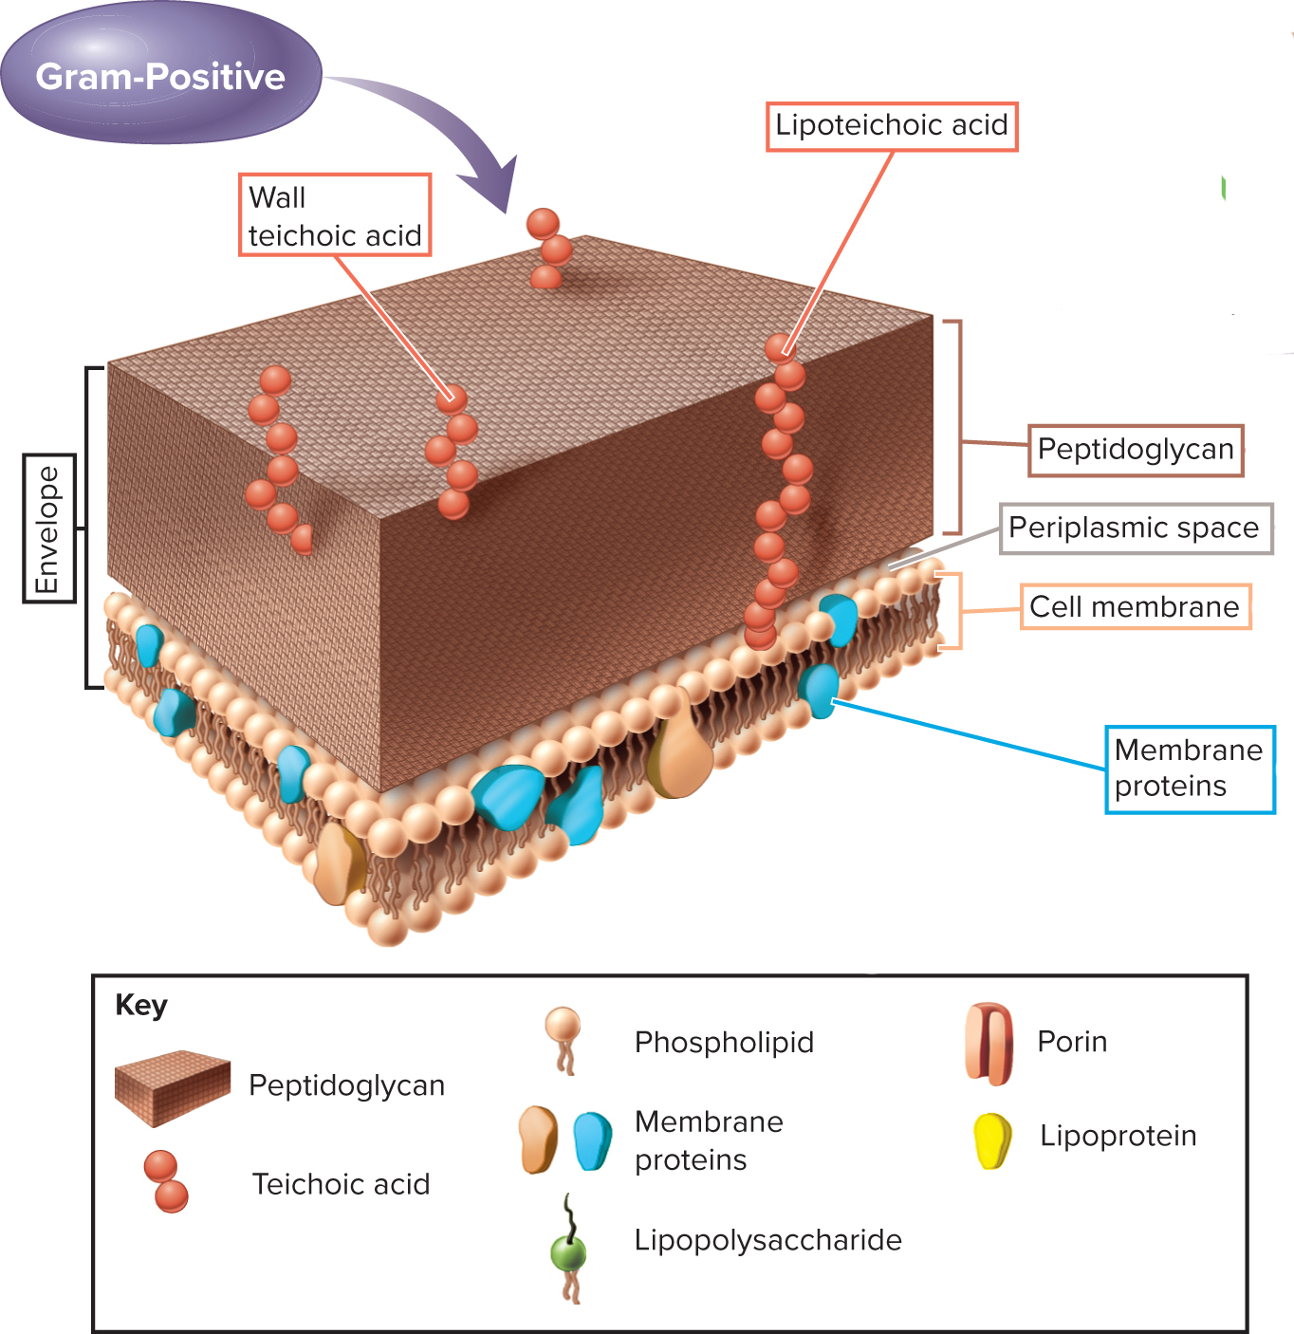
Gram-Positive Cell Wall 2

Slide 33
Gram-Negative Cell Wall 1
  Inner and outer membranes and periplasmic space between them contains a thin peptidoglycan layer
  Outer membrane contains lipopolysaccharides (LPS)
  Lipid portion (endotoxin) may become toxic when released during infections
  May function as receptors and blocking immune response
  Contain porin proteins in upper layer – regulate molecules entering and leaving cell

Slide 34
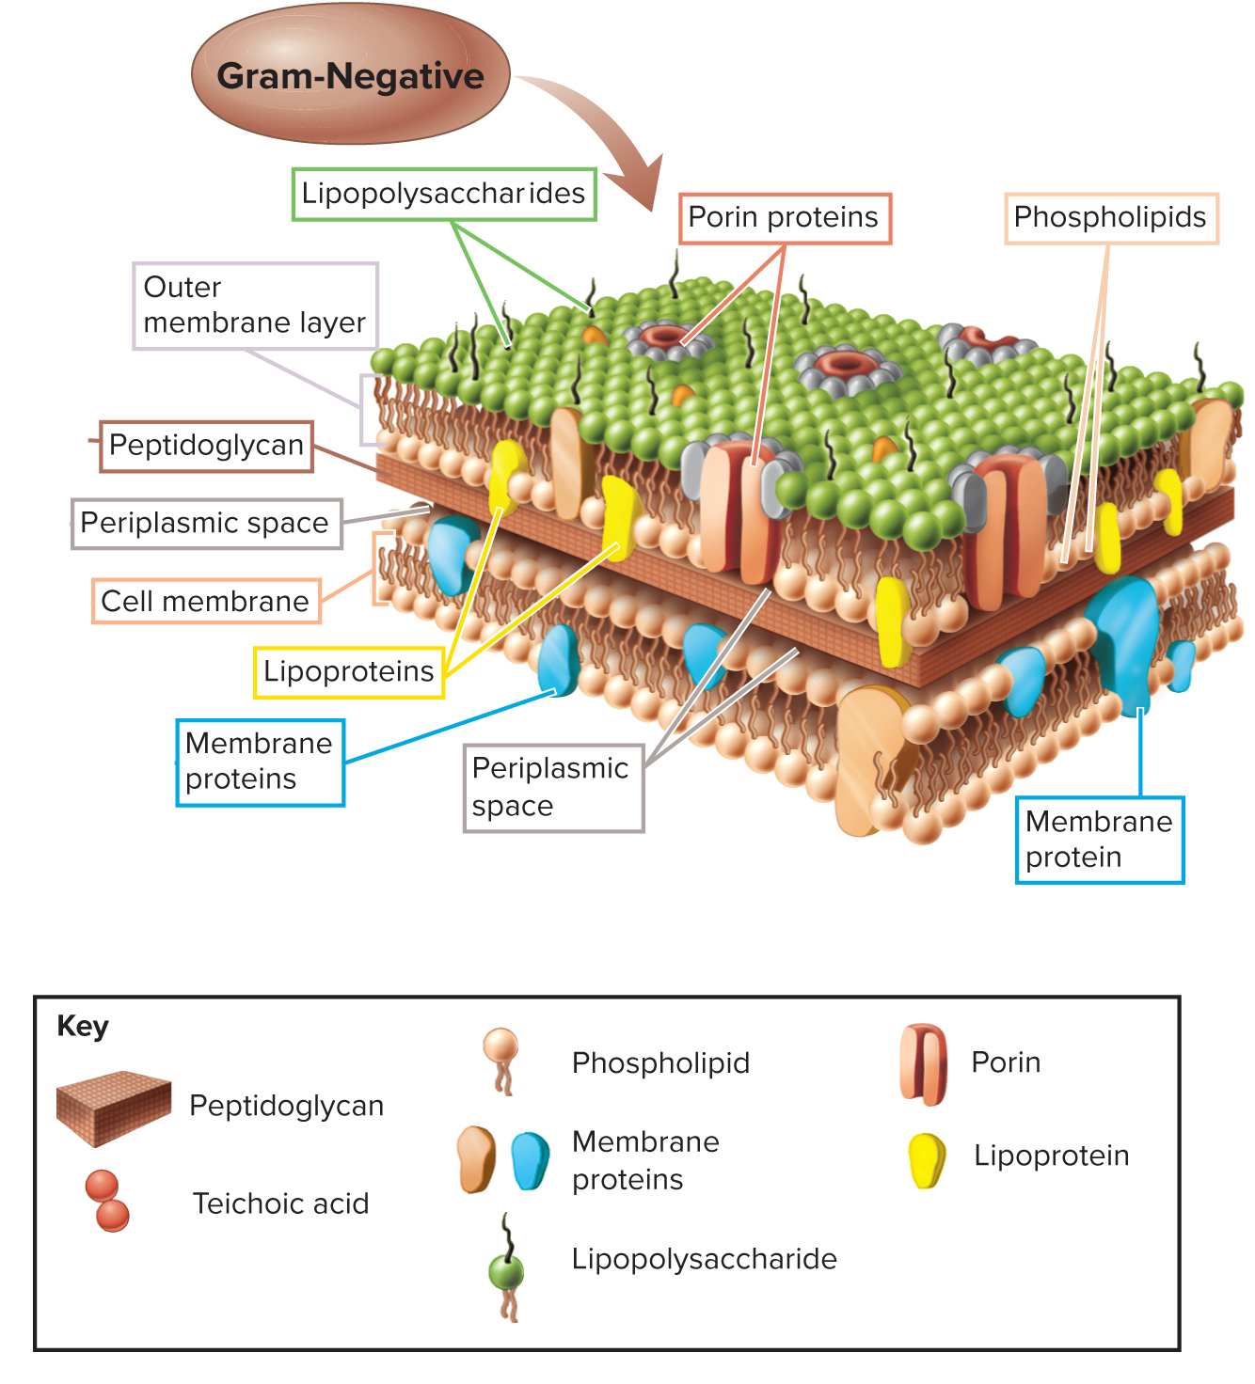
Gram-Negative Cell Wall 2

Slide 35
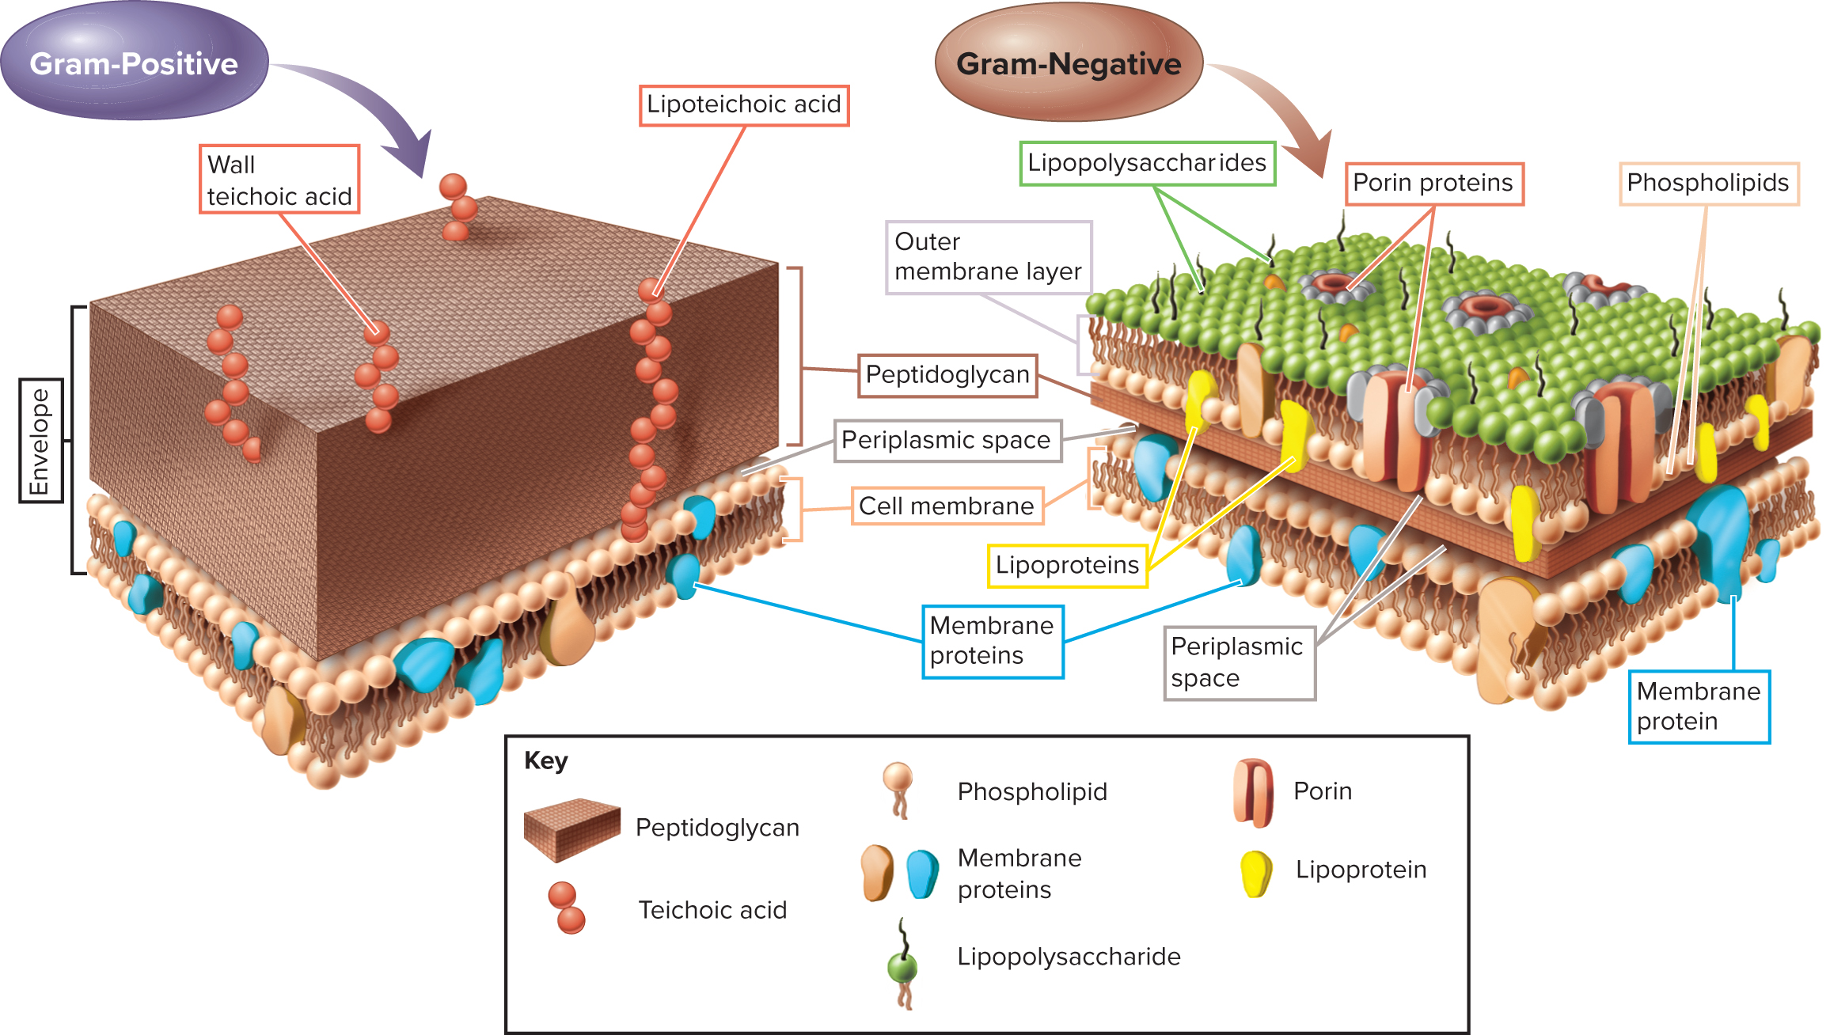
Structures of Gram-Positive and Gram-Negative Bacterial Cell Walls

Slide 36
TABLE 4.1 Comparison of Gram-Positive and Gram-Negative Cell Walls
Characteristic | Gram-Positive | Gram-Negative
Number of major layers | One | Two
Chemical composition | Peptidoglycan Teichoic acid Lipoteichoic acid Mycolic acids and polysaccharides* | Lipopolysaccharide (LPS) Lipoprotein Peptidoglycan Porin proteins
Overall thickness | Thicker (20-80 nm) | Thinner (8-11 nm)
Outer membrane | No | Yes
Periplasmic space | Narrow | Extensive
Permeability to molecules | More penetrable | Less penetrable
*In some cells.
Notes:
Copyright © McGraw-Hill Education. All rights reserved. No reproduction or distribution without the prior written consent of McGraw-Hill Education.

Slide 37
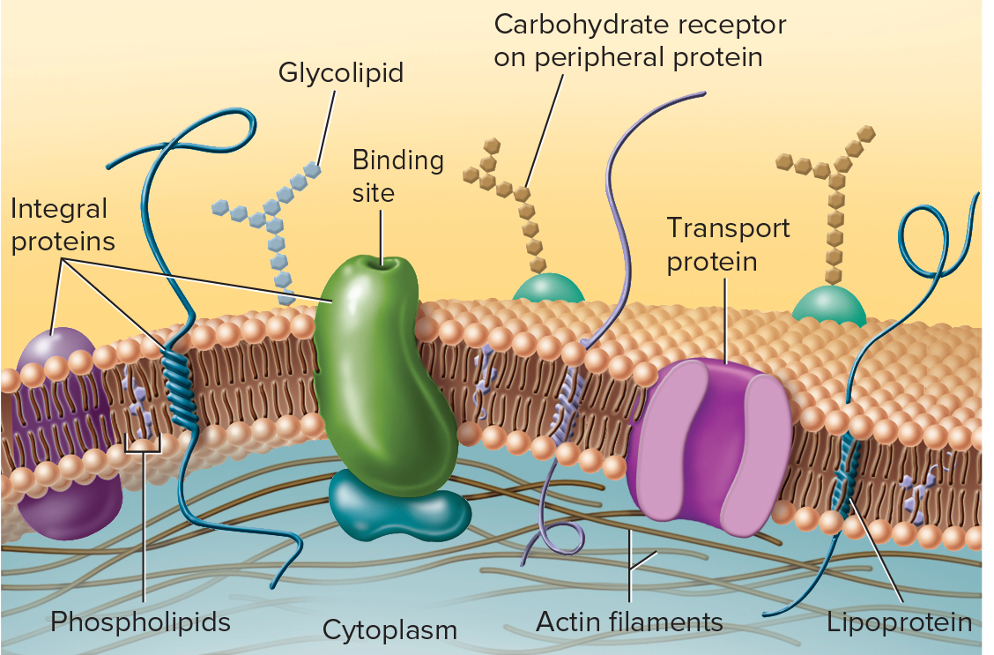
Cell Membrane Structure 1
Phospholipid bilayer with embedded proteins–fluid mosaic model
Functions in:
  Providing site for energy reactions, nutrient processing, and synthesis
  Passage of nutrients into the cell and discharge of wastes
  Cell membrane is selectively permeable

Slide 38
Inside the Bacterial Cell
Cell cytoplasm:
  Dense gelatinous solution of sugars, amino acids, and salts
  70 to 80% water
    Serves as solvent for materials used in all cell function

Slide 39
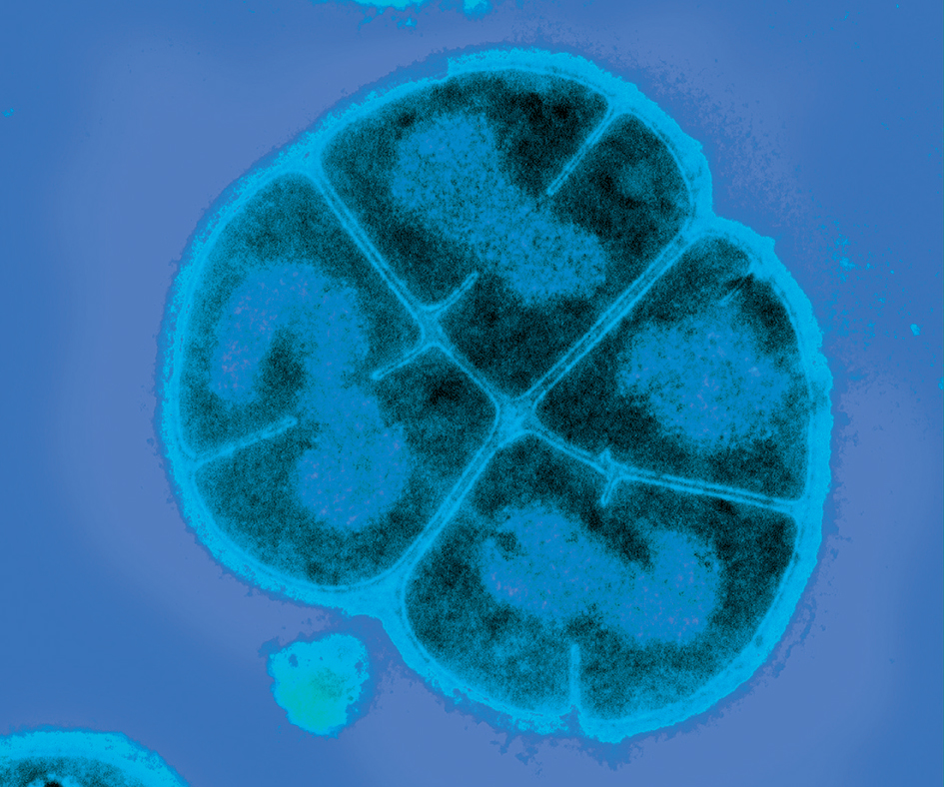
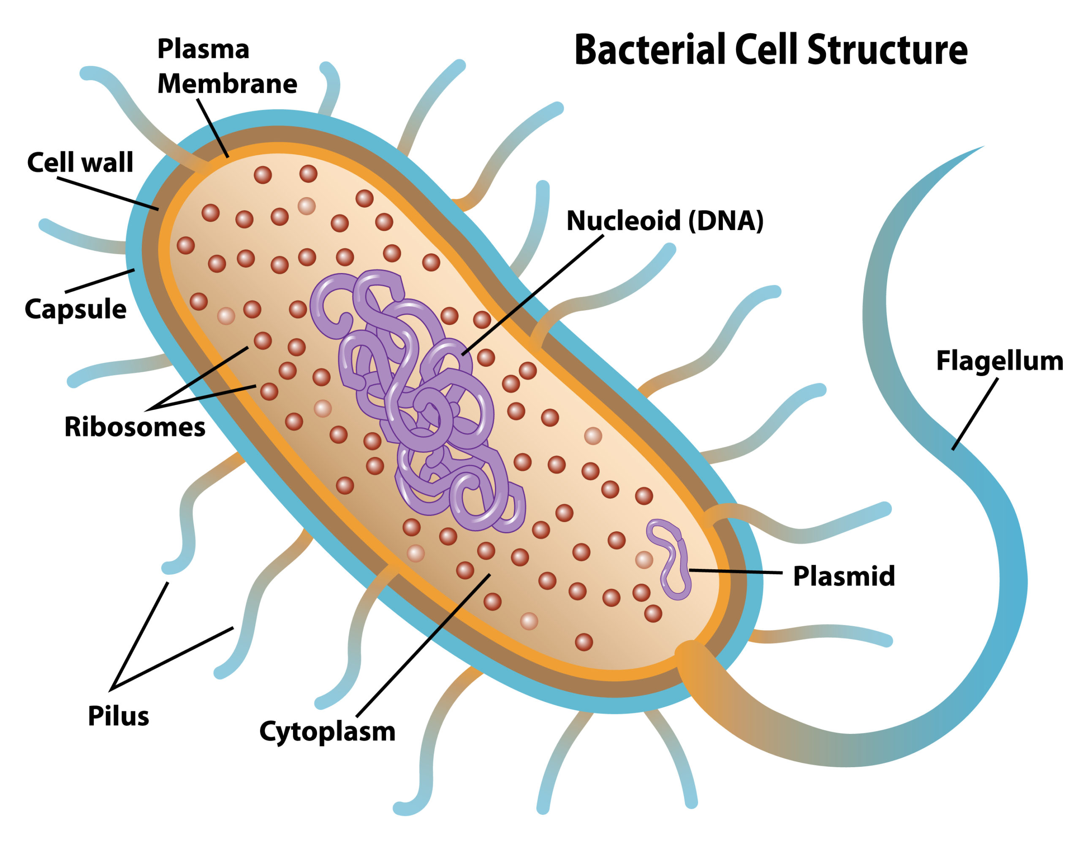
Nucleoid 1
Chromosome
  Single, circular, double-stranded DNA molecule that contains all the genetic information required by a cell
Plasmids
  Free small circular, double-stranded DNA
  Not essential to bacterial growth and metabolism
  Used in genetic engineering - readily manipulated and transferred from cell to cell
Nucleoid
Plasmid

Slide 40
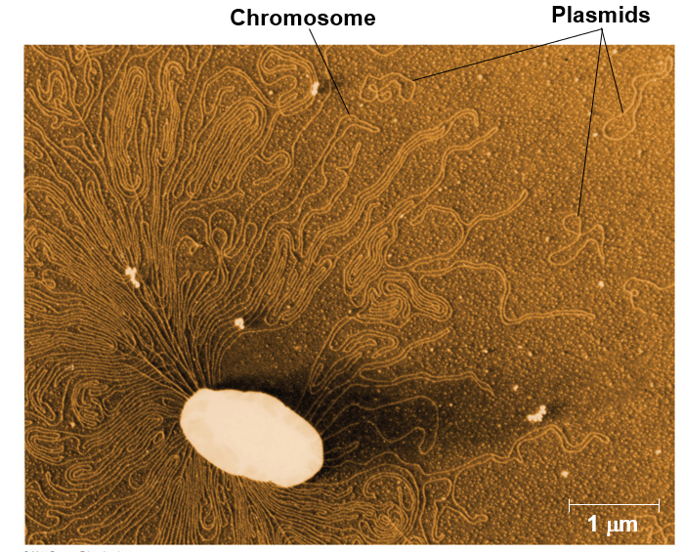
Bacterial chromosome and plasmids

Slide 41
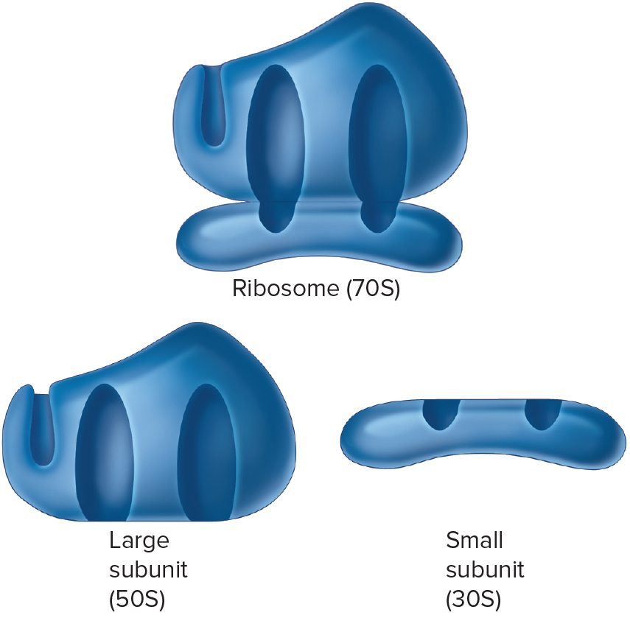
Bacterial Ribosome 1
Ribosomes
  Made of 60% ribosomal RNA and 40% protein
  Consist of two subunits: large and small
  Prokaryotic differ from eukaryotic ribosomes in size and number of proteins
  Site of protein synthesis
  Found in all cells
Ribosome (70S)
Large subunit (50S)
Small subunit (30S)

Slide 42
Bacterial Internal Structures 1
Inclusions and granules
  Intracellular storage bodies
  Vary in size, number, and content
  Bacterial cell can use them when environmental sources are depleted

Slide 43
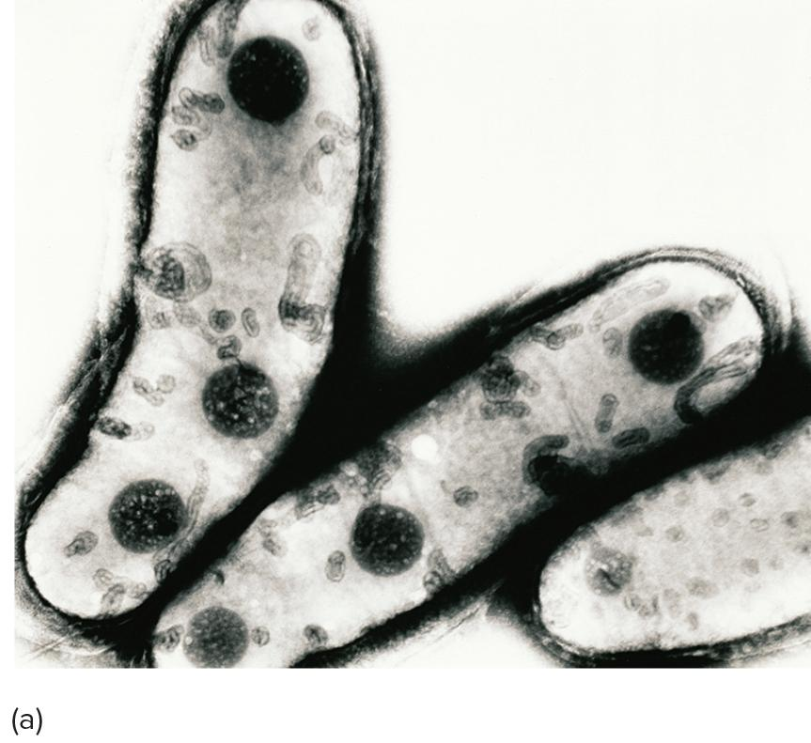
Bacterial Internal Structures 2
particles of polyhydroxybutyrate
Large, dark particles of polyhydroxybutyrate are deposited in an insoluble, concentrated form that provides long term supply of that nutrient.

Slide 44
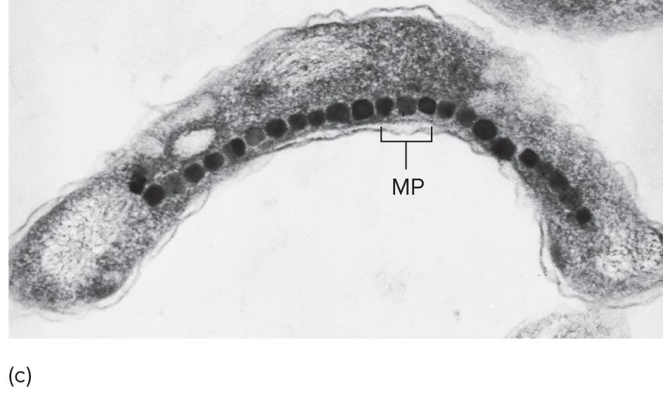
Bacterial Internal Structures 3
A section through Aquaspirillum reveals a chain of tiny iron magnets (magnetosomes = MP). These unusual bacteria use these inclusion to orient within their habitat.

Slide 45
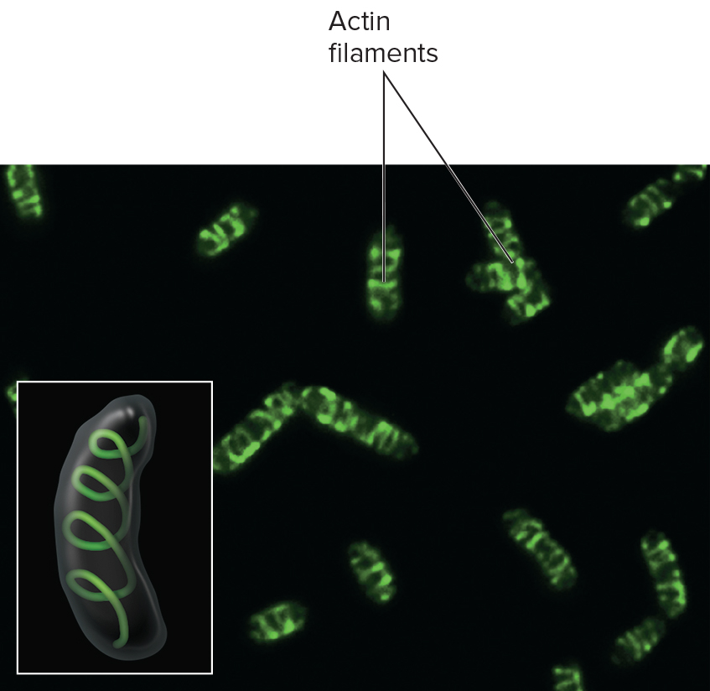
Bacterial Internal Structures 4
Cytoskeleton
  Many bacteria possess an internal network of protein polymers that is closely associated with the cell wall
Plays crucial roles in defining cell shape, aides in cell division, motility and partitioning of cellular structures.

Slide 46
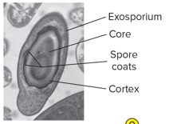
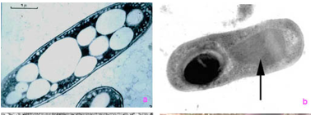
Bacterial Internal Structures 6
Endospores
  Inert, resting, cells produced by some bacteria: Clostridium, Bacillus, and Sporosarcina
    Have a 2-phase life cycle:
      Vegetative cell – metabolically active and growing
      Endospore – when exposed to adverse environmental conditions; capable of high resistance and very long-term survival
Endospores

Slide 47
Bacterial Internal Structures 7
  Sporulation - formation of endospores
    Hardiest of all life forms
    Withstands extremes in heat, drying, freezing, radiation, and chemicals
    Not a means of reproduction
  Germination - return to vegetative growth

Slide 48
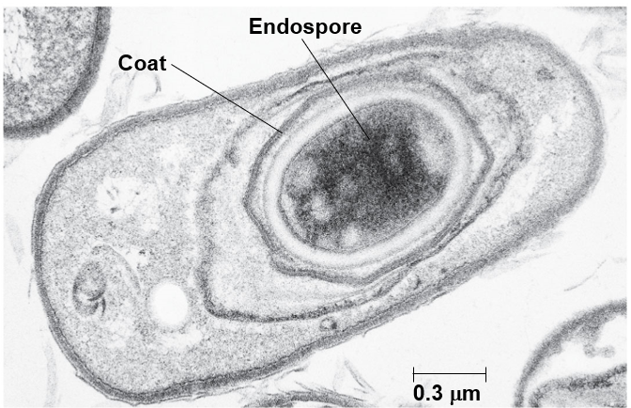
Endospores
Dehydrated, metabolically inactive
Thick coat
Longevity verges on immortality, 250 million years
Resistant to ordinary cleaning methods and boiling
Pressurized steam at 120°C for 20-30 minutes will destroy

Slide 49
Bacterial Shapes, Arrangements, and Sizes
Vary in shape, size, and arrangement but typically described by one of three basic shapes:
  Coccus – spherical
  Bacillus – rod
    Coccobacillus – very short and plump
    Vibrio – gently curved
  Spirillum – helical, comma, twisted rod,
    Spirochete – spring-like

Slide 50
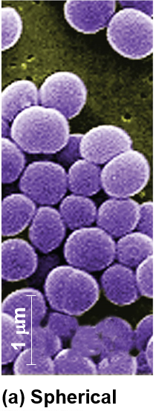
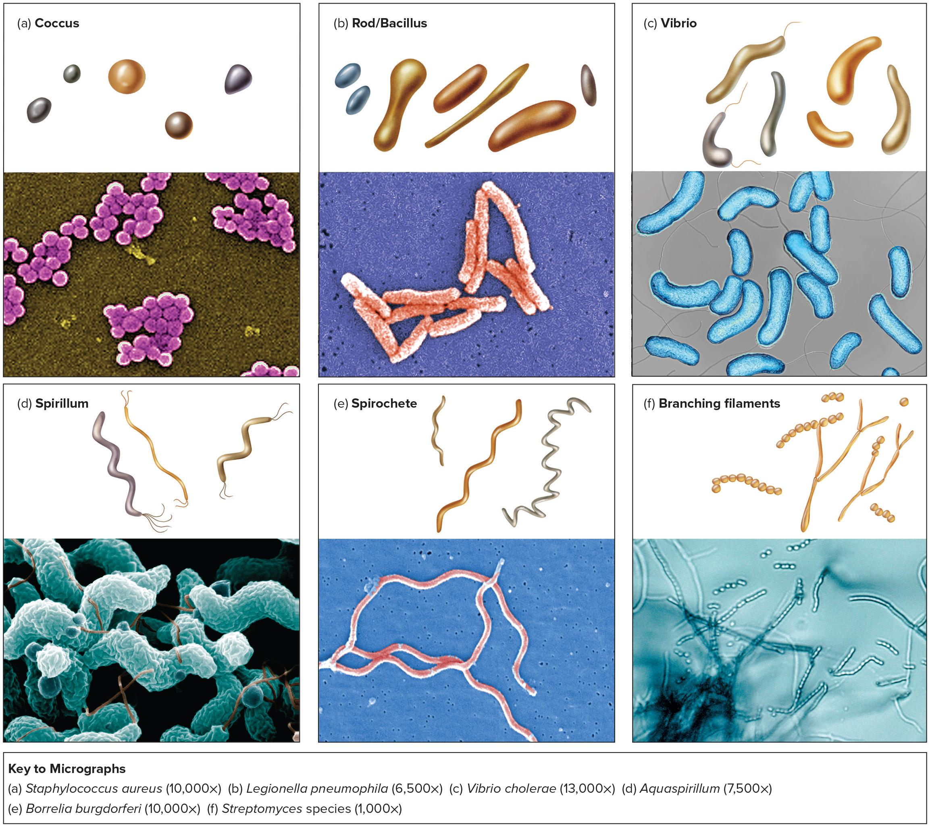
Common Bacterial Shapes 1
Coccus
Staphylococcus aureus (10,000x)
Part A depicts the coccus which is tiny circular bead-shaped bacteria.

Slide 51
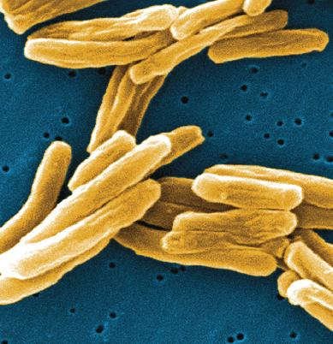
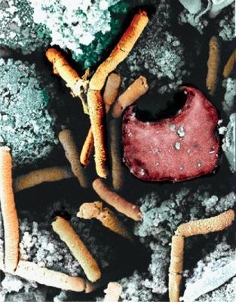
Common Bacterial Shapes 2
Rod/Bacillus
Mycobacterium tuberculosis—the bacillus that causes tuberculosis.
Legionella pneumophilia (6,500x)
Part B depicts the rod or bacillus resembling a rod-shaped bacterium.
Bacillus anthracis—SEM micrograph showing the rod-shaped cells next to a red blood cell.

Slide 52
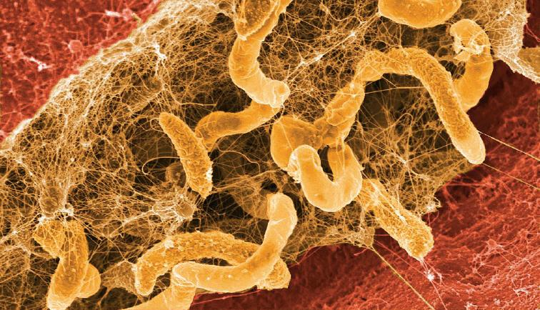
Common Bacterial Shapes 3
Vibrio
A vibrio-shaped thermophile, Desulfovibrio, living in a pond biofilm.
Vibrio cholerae (13,000x)
Part C depicts the vibrio which are elongated rod-shaped bacteria with a thread-like filament extending out from either side.

Slide 53
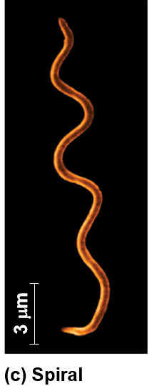
Common Bacterial Shapes 4
Spirillum
Aquaspirillum (7,500x)
Part D depicts the spirillum which has a curved surface with branching flagella on either end.

Slide 54

Common Bacterial Shapes 5
Spirochete
Treponema pallidum – spirochetes that cause syphilis.
Borrelia burgdorferi (10,000x)
Part E depicts the spirochete having a subsequent curved pattern throughout.

Slide 55
Common Bacterial Shapes 6
Branching filaments
Streptomyces species (1,000x)
Part F depicts the branching filaments with a chain of bead-like elements.

Slide 56

Pleomorphism 1
Variation in cell shape and size within a single species
Pleomorphism of Corynebacterium. Cells are irregular in shape and size (800x).

Slide 57
Bacterial Arrangements 1
Arrangement of cells is dependent on pattern of division and how cells remain attached after division:
  Cocci:
    Singles
    Diplococci – in pairs
    Tetrads – groups of four
    Irregular clusters – staphylococci and micrococci
    Chains – streptococci
    Cubical packets (sarcina)
  Bacilli:
    Diplobacilli – a pair
    Chains – streptobacilli
    Palisades

Slide 58


Bacterial Arrangements 2
Streptococcus pneumoniae — image displays the diplococcus arrangement of this species.

Slide 59
Bacterial Arrangements 3

Slide 60
Bacterial Arrangements 4

Slide 61
Any questions, please feel free to ask.
Thank you !

